Slide 1
TEAM UP
BY-
Akanksha Dayal
Pranjal Bhushan
Yash Shah
Satyam Rajput
Vardhan Hingonia
Divyansh Chaudhary

Slide 2
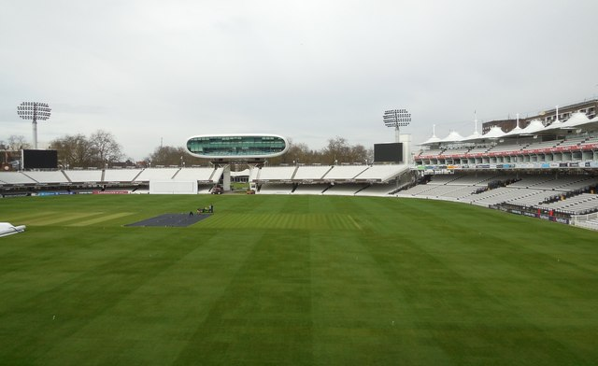
ROUND 1
INDIA VS NEW ZEALAND (ODI MATCH)
PARTICIPANTS WILL BE GIVEN 30 PLAYERS FROM EACH TEAM.
IN ROUND 1,THEY HAVE TO SELECT 16 PLAYERS FROM EACH TEAM.
8 BATSMEN (INCLUDING MINIMUM 2 WK)
5 BOWLERS
3 ALL ROUNDERS

Slide 3
WRITE THE NAME OF 16 PLAYERS WHO YOU THINK ARE ELIGIBLE TO
PLAY AND SEND THE TYPED/HANDWRITTEN PDF TO THE FOLLOWING ID.
ID - _______________@gmail.com
PARTICIPANTS WILL BE GIVEN POINTS OUT OF 16. AND THOSE WITH MAXIMUM SCORE OUT OF 16 WILL BE SELECTED FOR ROUND 2.
NOTE – NAME OF 30 PLAYERS WITH THEIR CRICKET SKILL DETAILS AND PITCH CONDITIONS WILL BE PROVIDED VIA GOOGLE DRIVE LINK.

Slide 4
AFTER 10 MINS RESULT OF ROUND 1 WILL BE DECLARED AND THE SELECTED PARTICIPANTS WILL RECEIVE A MAIL, WHICH WILL INCLUDE A GOOGLE MEET LINK FOR THE NEXT ROUND.
ROUND 1 CONCLUDED

Slide 5
ROUND 2
PARTICIPANTS WILL BE PROVIDED AN UPDATED PITCH CONDITION AND THEY HAVE TO SELECT PLAYING 11 FROM BOTH THE TEAMS.
10 MINS WILL BE PROVIDED TO WRITE OR TYPE THE NAME OF PLAYERS AND THEN THEY HAVE TO MAIL IT TO THE FOLLOWING ID.
___________________@gmail.com
PARTICIPANTS WILL BE GIVEN POINTS OUT OF 11 AND THE SHORT LISTED WILL BE SELECTED FOR ROUND 3.

Slide 6
ROUND 3
SHORT LISTED PARTICIPANTS HAVE TO WRITE DOWN NAMES OF
THESE 6 PLAYERS:
CAPTAIN (10 POINTS)
VICE CAPTAIN (8 POINTS)
MOST RUNS SCORED (7 POINTS)
MOST WICKETS TAKEN (7 POINTS)
MOST CATCHES (4 POINTS)
MAN OF THE MATCH (4 POINTS)
AFTER LISTING OUT THESE NAMES, THEY HAVE TO SEND THE PDF
TO MENTIONED ID.
_____________@gmail.com

Slide 7
WE ORGANIZERS WOULD HAVE CREATED A HYPOTHETICAL GAME WITH PITCH CONDITIONS AND THE NAMES OF PLAYER IN THE ABOVE LIST.
STUDENTS WILL BE GIVEN MARKS OUT OF 40 AND TOP 3 STUDENTS WILL BE REWARDED WITH PRIZE MONEY.
1^{ST -}
2ND -
3^{RD -}

